Slide 1
Four Axis Robotic Manipulator
Halil KACMAZ

Slide 2
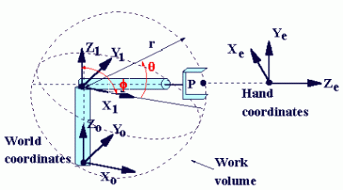
What is working space?
What is axis?

Slide 3
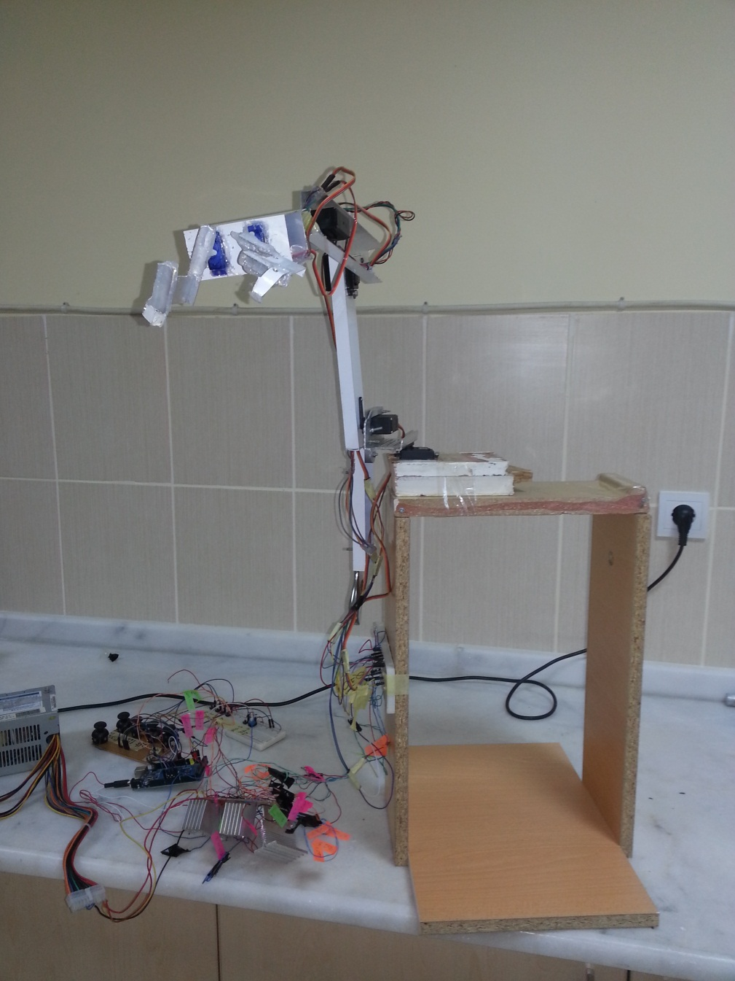
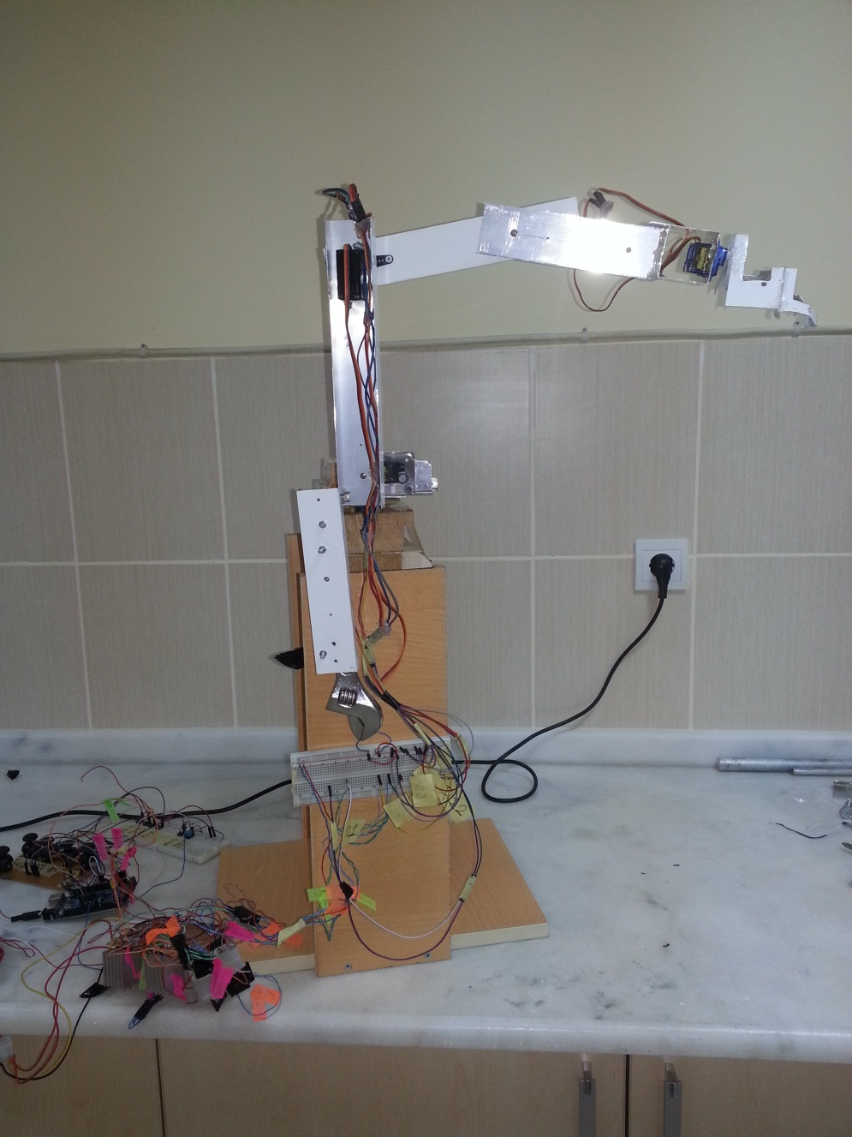
Robotic Arm
Dört Eksen

Slide 4
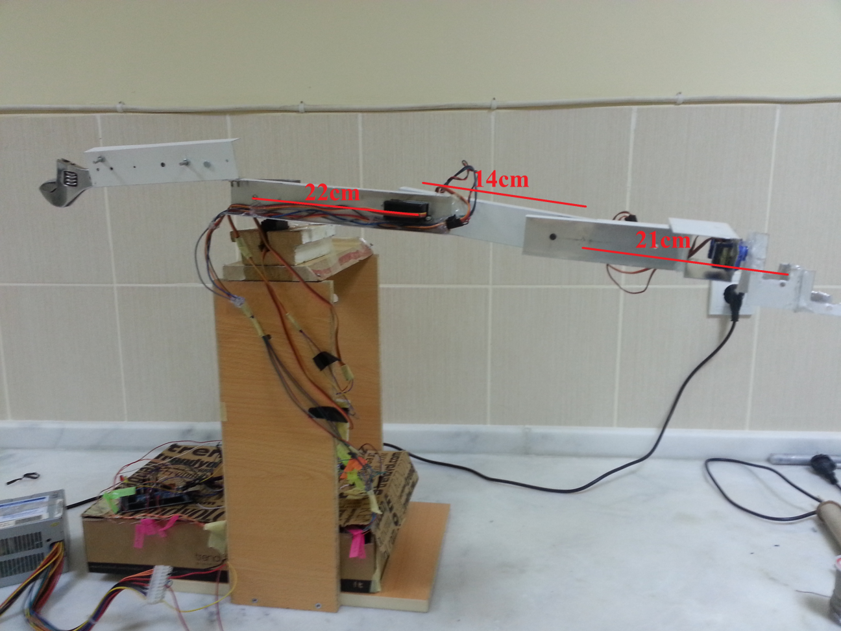
Robotic Arm

Slide 5
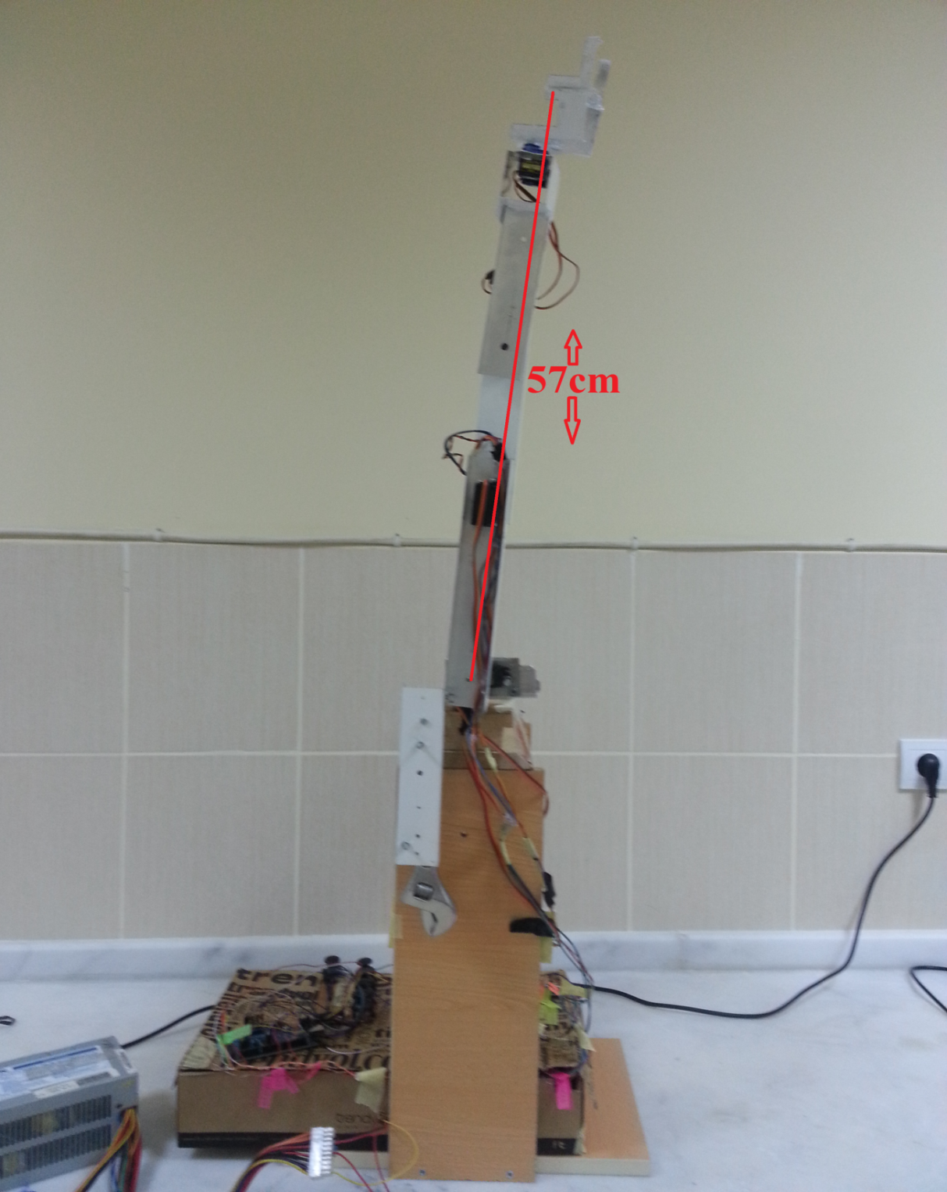

Robotic Arm
57cm total reach
$775734{cm}^{3}$
$$Working space volume$$

Slide 6
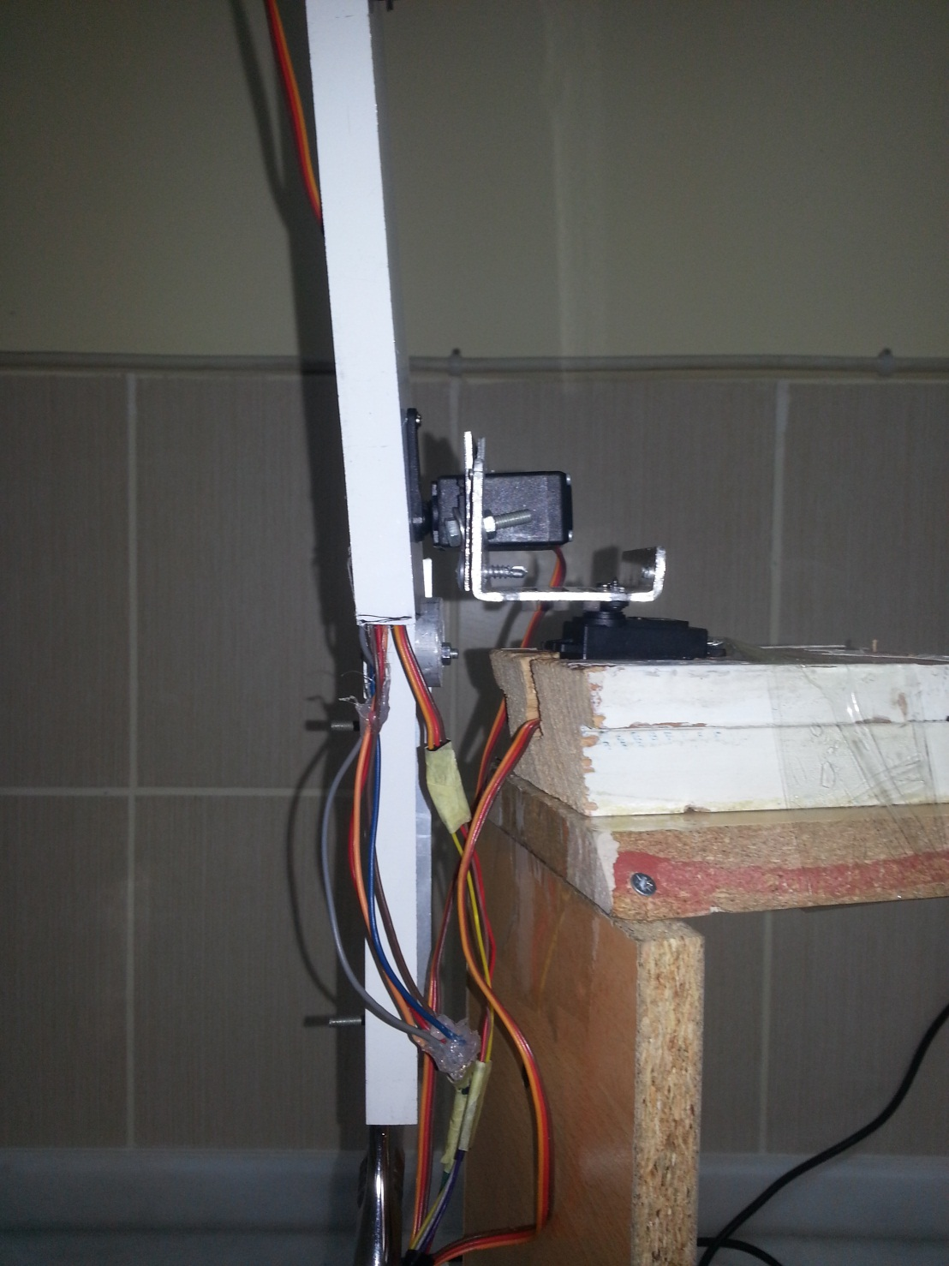
Robotic Arm
1st and 2nd axis

Slide 7
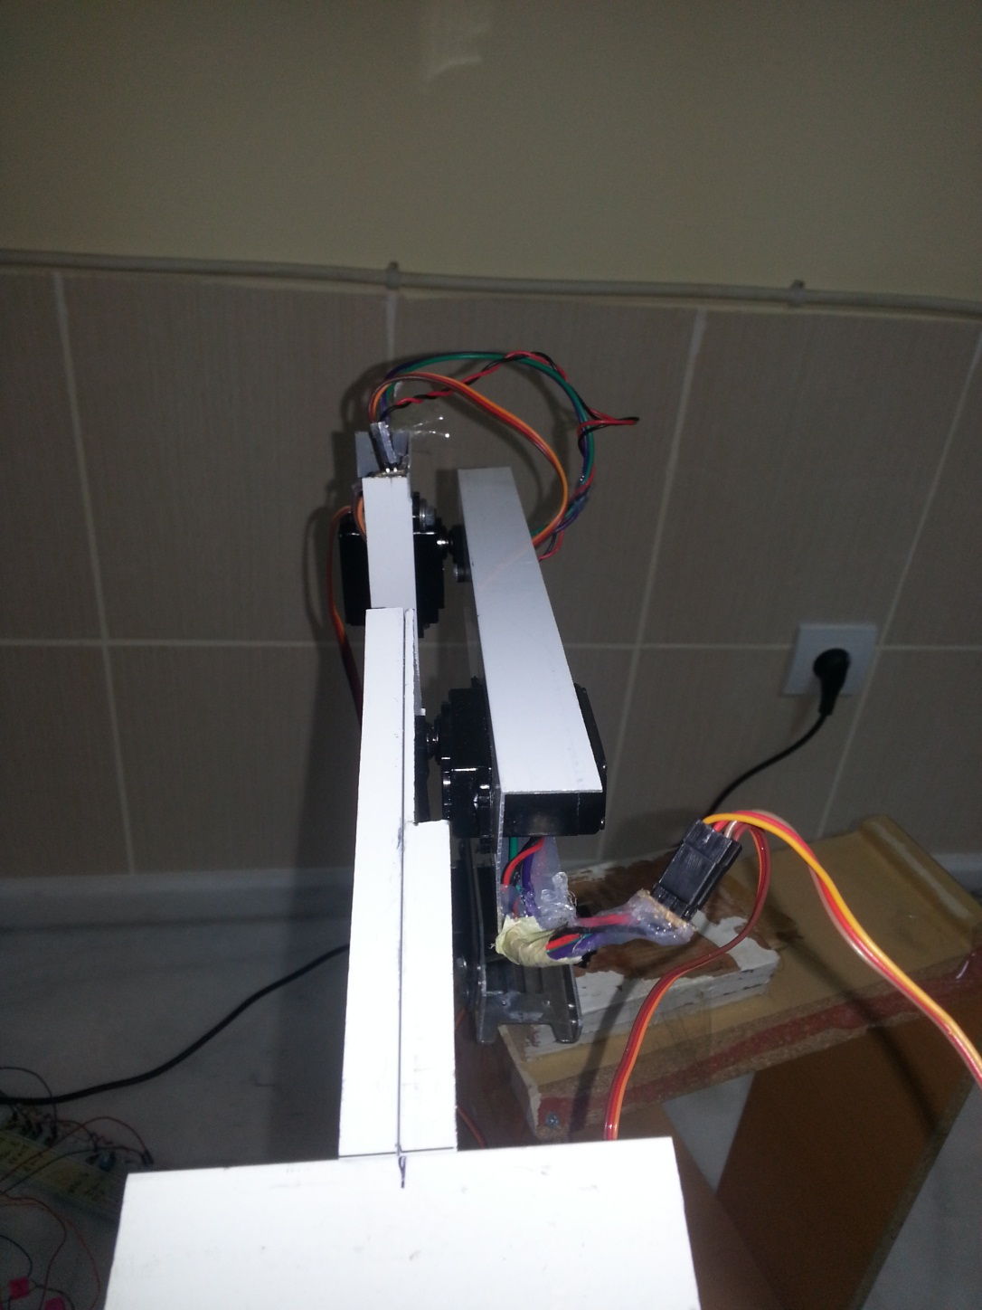
Robotic Arm
3rd and 4th axis

Slide 8
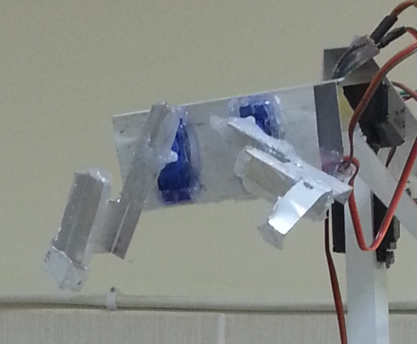
Gripper
Gripper

Slide 9
Control circuit layout

Slide 10
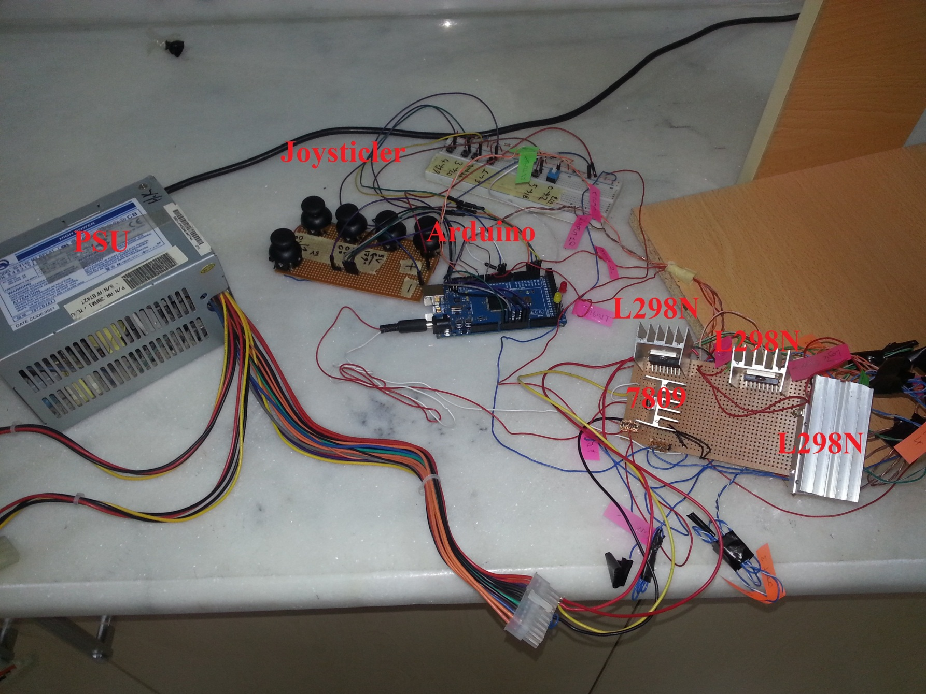
Control circuit all connections

Slide 11
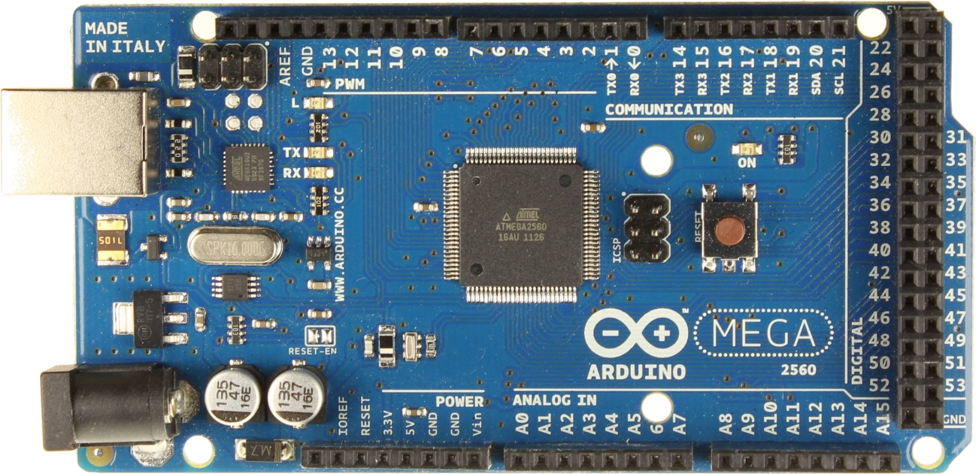
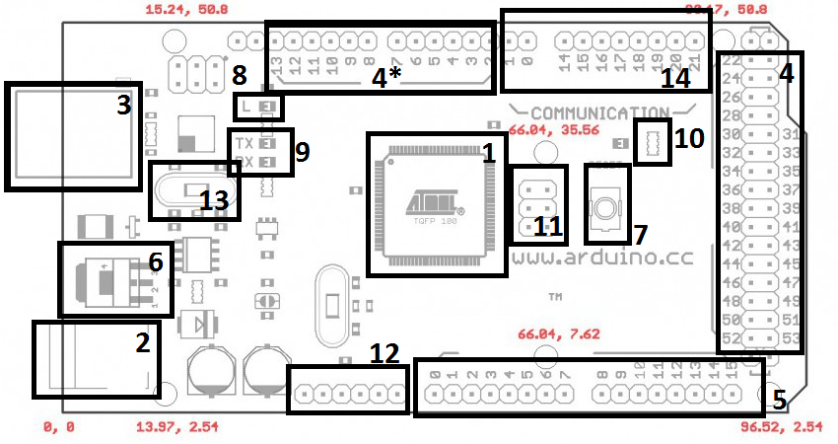
Control circuit » Arduiono Mega 2560 R3

Slide 12
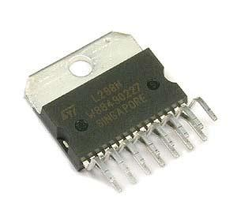
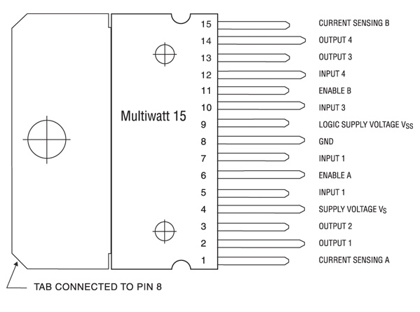

Control circuit components » L298N

Slide 13
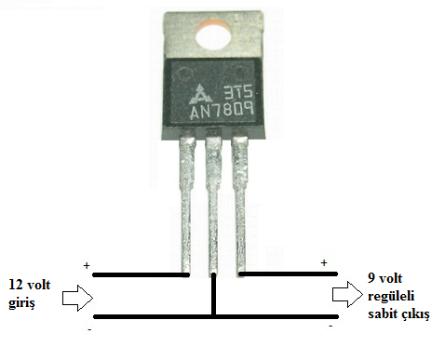

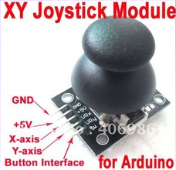
Control circuit components » 7809, Joystick

Slide 14
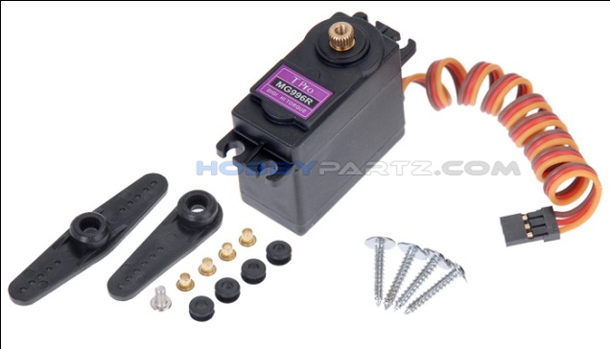
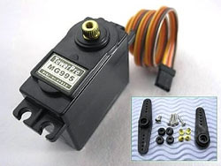
Control circuit components » Axis Servos
Büyüklük: 40.6 x 19.8 x 42.9 mm
Ağırlık: 50 g
Hız @4.8V: 0.15 sn/60°
Zorlanma Torku @4.8V: 13 kg·cm
Zorlanma Torku @6V: 15 kg·cm
Power: Kırmızı
Ground: Kahverengi
Signal: Sarı
Büyüklük: 40.6 x 19.8 x 36.5 mm
Ağırlık: 50 g
Hız @4.8V: 0.15 sn/60°
Zorlanma Torku @4.8V: 13 kg·cm
Zorlanma Torku @6V: 15 kg·cm
Power: Kırmızı
Ground: Kahverengi
Signal: Sarı

Slide 15
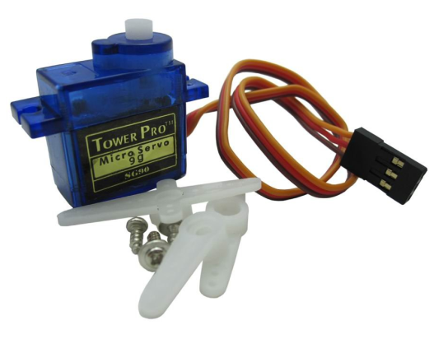
Control circuit components » Gripper Servos
Büyüklük: 22 x 11.5 x 27 mm
Ağırlık: 9 g
Hız @4.8V: 0.12 sn/60°
Zorlanma Torku @4.8V: 1.2 kg·cm
Zorlanma Torku @6V: 1.5 kg·cm
Power: Kırmızı
Ground: Kahverengi
Signal: Sarı

Slide 16
Control circuit layout

